Slide 1
ONLINE BUS BOOKING SYSTEM
SUB –WEB DEVELOPMENT
EN. NO -180160116040
EN. NO – 180160116041
EN. NO - 180160116029

Slide 2
Introduction
The Online bus ticket Reservation System is a web-based application that allows visitors check bus ticket availability.
Buy Bus tickets and pay the bus ticket online.
This System Established for the all the home/office users after gaining access from administrator.
You can choose your preferred seats.

Slide 3
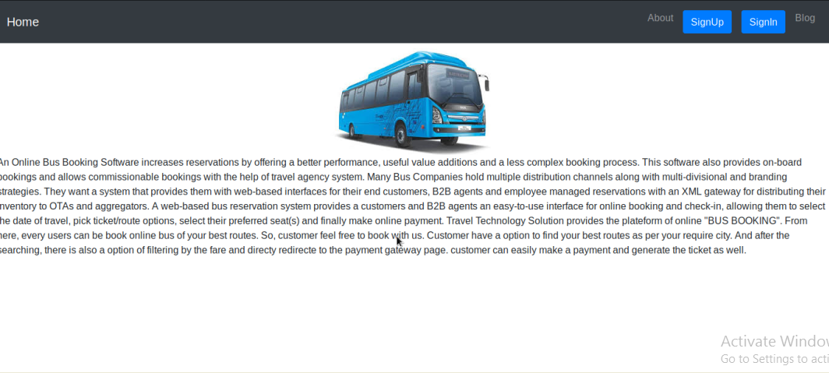
Home page

Slide 4
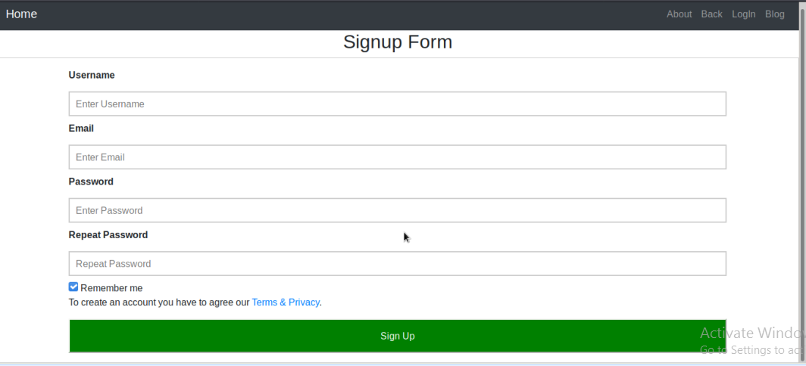
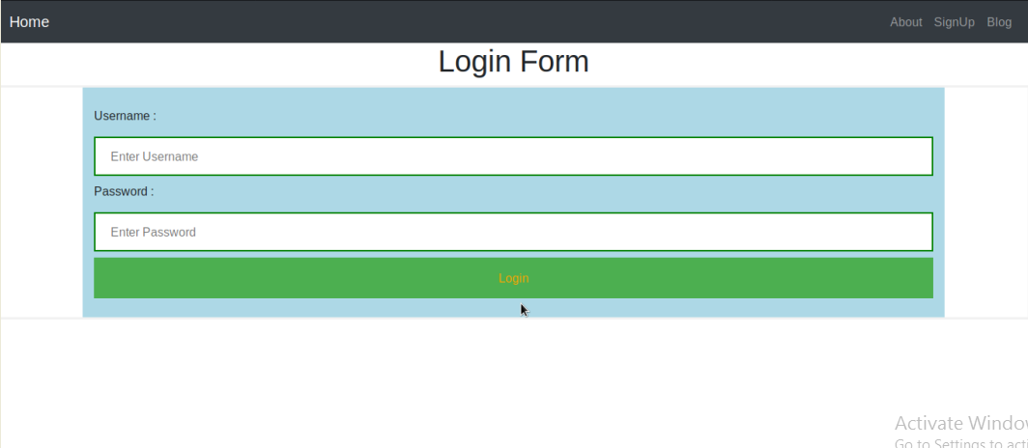
SING UP/SING IN FORM

Slide 5
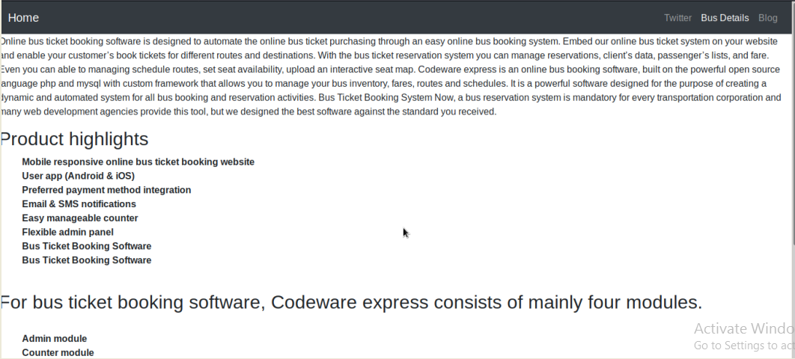
MODULES

Slide 6
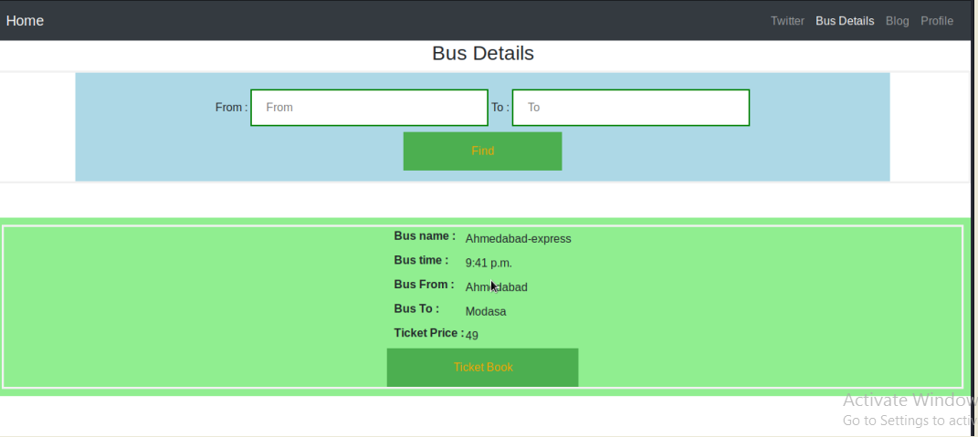
HOW TO CHECK BUS/AVAILABILITY

Slide 7
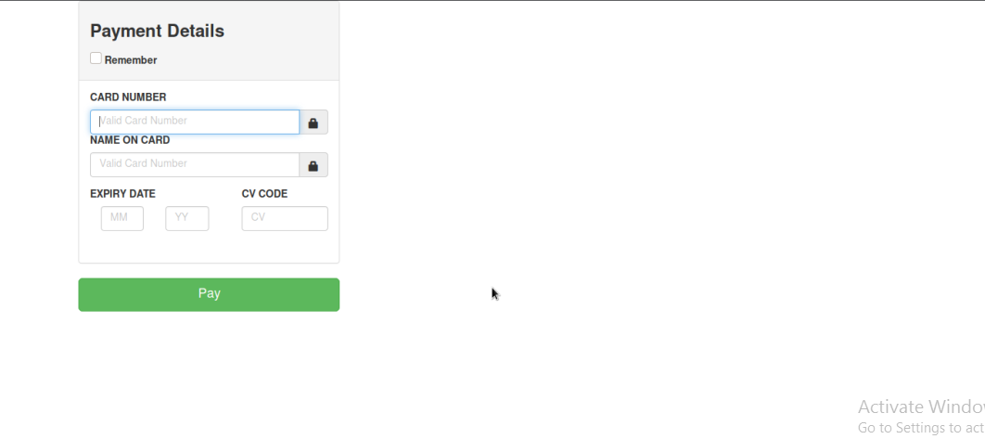
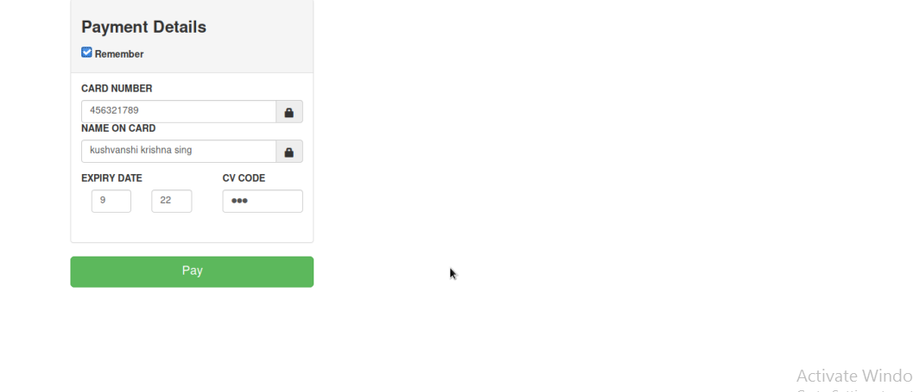
PAYMENT METHODS

Slide 8
ADVANTAGES
Save Time With our current professional schedule and personal commitments we seldom get time for our selves and our families
Live Tracking
Highly Convenient Another major advantages of online bus booking is the convenience that it offers.
Easy pickup And Drop
Offers and Discount

Slide 9
DISADVANTAGES
You need internet access
You need to be ready for an influx of new customers
Not all online booking systems are created equal
Avoid booking systems that don’t bring you new quality customers.

Slide 10
THANK YOU
.

